Slide 1
R. Johnsonbaugh
Discrete Mathematics
5th edition, 2001
Chapter 11
Computational Geometry

Slide 2
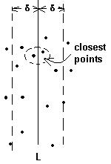
11.1 The closest pair problem
Problem:
Given n points in the plane
find a closest pair
with distance measured in ordinary Euclidean geometry.

Slide 3
Closest points algorithms
Two important algorithms:
"List all" algorithm.
  There are C(n,2) = n(n-1)/2 pairs
  so this algorithm is Θ(n²)
"Divide-and-conquer closest-pair algorithm"
  which is Θ(n lg n) in its worst case.

Slide 4
11.2 A lower bound for the closest-pair algorithm
Theorem 11.2.1: The worst-case time for any algorithm that solves the problem of determining whether n real numbers are distinct is Ω(n lg n).
Corollary 11.2.2: The worst-case time for any algorithm that finds the distance between a closest pair among n elements in the plane is Ω(n lg n).

Slide 5
11.3 An algorithm to compute the convex hull
Given a finite set S of points in the plane
a point P is a hull point if there is a straight line L through P so that all points in S (except P) fall on one side of L.
the convex hull is the convex polygon obtained by joining the hull points.

Slide 6
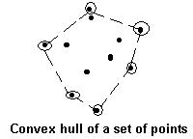
Ordering hull points
Order hull points on the XY plane as follows:
p₁ is the point with smallest y coordinate,
p₂ is the next, and so on.
If two hull points have the same y coordinate, choose the point with smallest x coordinate.

Slide 7
Cross product of three points
After all points have been ordered in ascending order by their y-coordinate,
next sort all points p in S according to the angle from the horizontal of the line p₁p.

Slide 8
Cross product of 3 points
Define the cross product of three points p_{k} = (x_{k},y_{k}), 0 < k < 2, as follows:
Cross(p₀,p₁,p₂) =
(y₂ -y₀)(x₁-x₀) – (y₁-y₀)(x₂ -x₀)

Slide 9
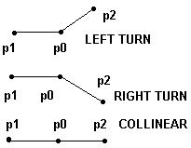
Cross product and turns
Theorem 11.3.5: If p₀, p₁ and p₂ are distinct points
in the plane,
a) p₁, p₀, p₂ make a left turn ⇔ cross(p₀,p₁,p₂) < 0
b) p₁, p₀, p₂ make a right turn ⇔ cross(p₀,p₁,p₂) > 0
c) p₁, p₀, p₂ are collinear ⇔ cross(p₀,p₁,p₂) = 0.

Slide 10
Graham's algorithm
Order n points in XY plane
  Ascending order according to Y coordinate
  Ascending order by angle from the horizontal
  Examine all points in order and discard those not in the convex hull
Worst-case time for Graham's algorithm is Ω(n lg n).

Slide 11
Computing the convex hull
Theorem 11.38: Any algorithm that computes the convex hull of n points in the plane has worst-case time Ω(n lg n).

